Slide 1


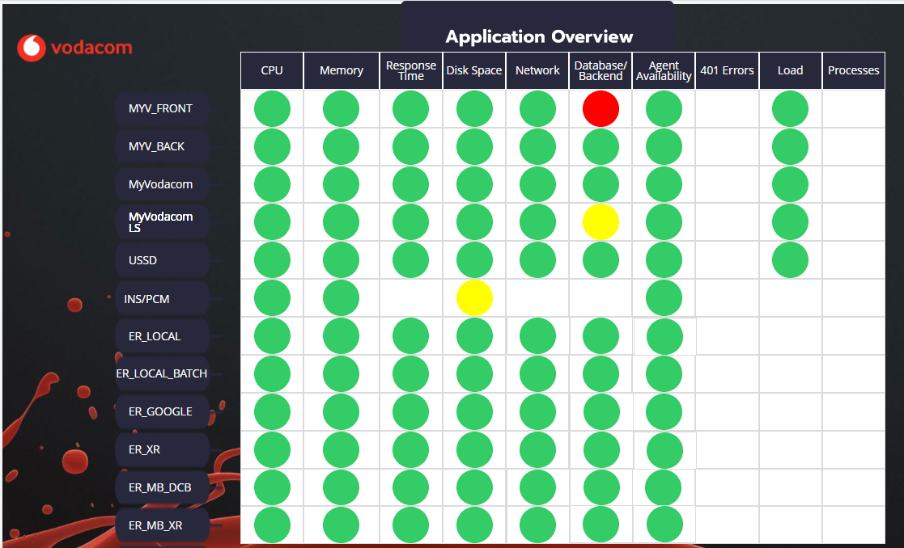
EXECUTIVE CNE OVERVIEW 2
System Resources
CPU, Memory, Disk Space: Metrics monitoring the core hardware resources usage.
Applications
System Monitoring Metrics
Application health indicators
Performance Metrics
Response Time, Load: Indicators of system speed and workload.
Good/Healthy/Normal
Indicates that the system or component is operating normally and within acceptable parameters
Network Metrics
Network: Measures of network activity and data transfer rates.
Application Health
Database/ Backend, Processes: Metrics for backend services and process management.
Warning/Caution
Indicates that there may be a potential issue or that something requires attention
Availability
Agent Availability: Status of monitoring agents' operational readiness.
Critical/Error/Failure
Indicates a serious problem that requires immediate attention
Security Metrics
401 Errors: Count of unauthorized access attempts.

